Slide 1


Good Cabs
Presented by: Dipesh Shah

Slide 2
Objective
Goodcabs, a cab service company established two years ago, which has gained a strong foothold in the market by focusing on top 10 tier 2 cities.
With operations in 10 cities across India Goodcabs have set ambitious target to drive growth and customer satisfaction.
As part of this initiative, the management aims to assess the company’s performance across key metrics including trips volume, passenger satisfaction, revenue generated, customer acquisition as well as retention.
Hence, We have to submit the findings to Chief of Operations of the Company Mr. Bruce.

Slide 3
Ad-hoc Requests
1. City level fare and Trip Summary Report
2. Monthly City level Trips Target Performance Report
3. City Level Repeat Passenger Trip Frequency Report
4. Identify Cities with highest and lowest total new passenger
5. Identify month with highest revenue for each city
6. Repeat Passenger Rate Analysis

Slide 4
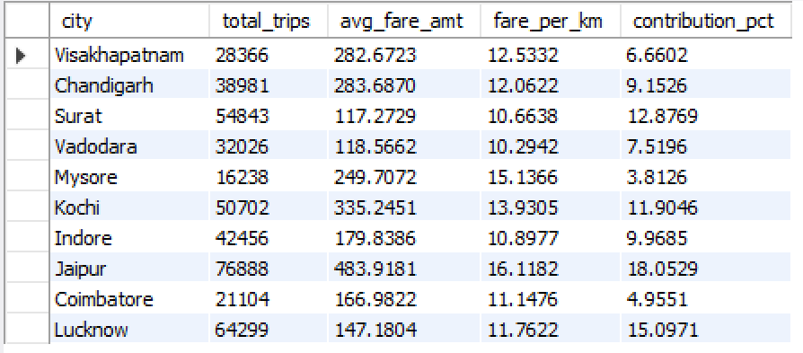
City level fare and Trip Summary Report

Slide 5

Monthly City level Trips Target Performance Report
Cities with reaching the target every month were Jaipur and Mysore.
Cities missing to reach the set benchmark every month were Vadodara and Lucknow.

Slide 6
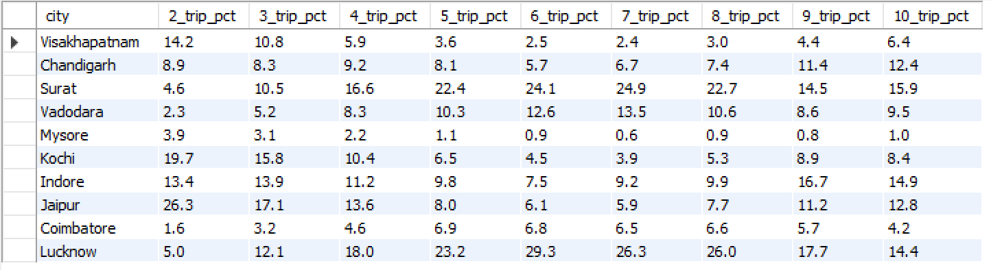
City Level Repeat Passenger Trip Frequency Report

Slide 7
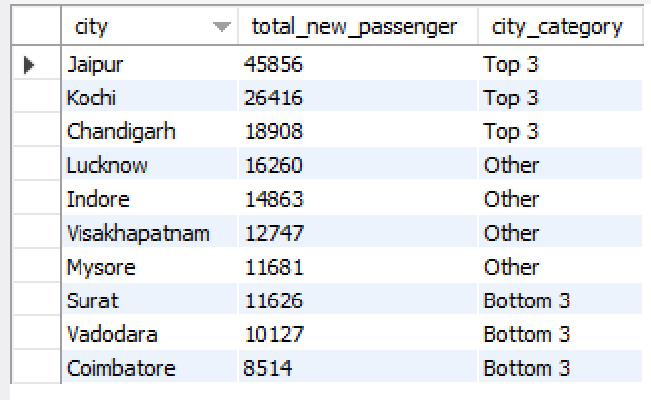
Identify Cities with highest and lowest total new passenger

Slide 8
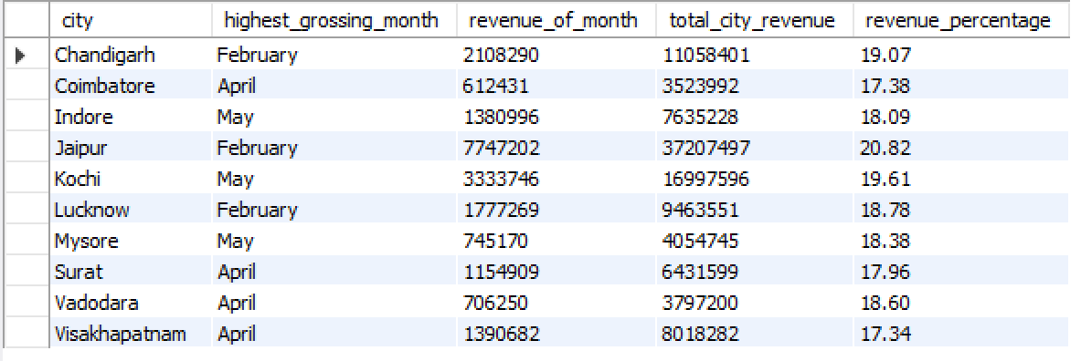
Identify month with highest revenue for each city

Slide 9

Repeat Passenger Rate Analysis
Top 3 Cities with Repeat Passenger Rate is Surat, Lucknow and Indore. With retention rate of 42.62%, 37.11% and 32.68% Respectively.
Whereas, Cities with lower retention rates were Mysore (11.22%), Jaipur (17.43%) and Chandigarh(21.14%).

